Slide 1
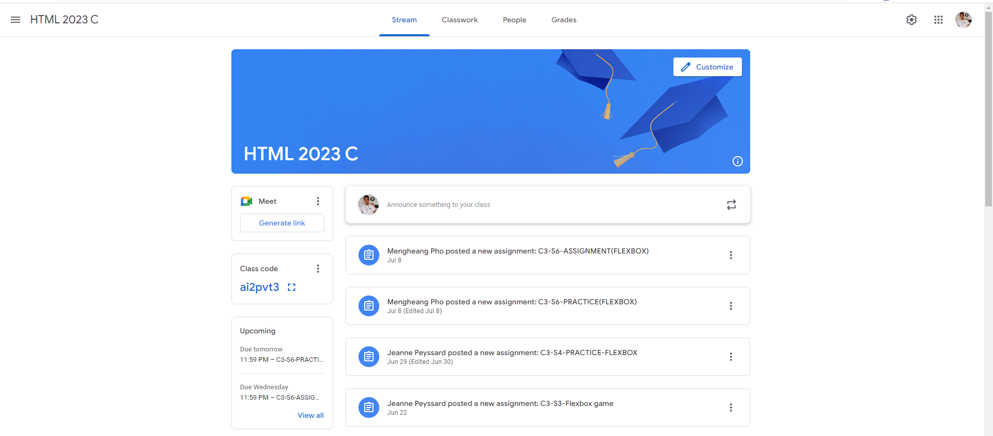
Identify root components of website below

Slide 2
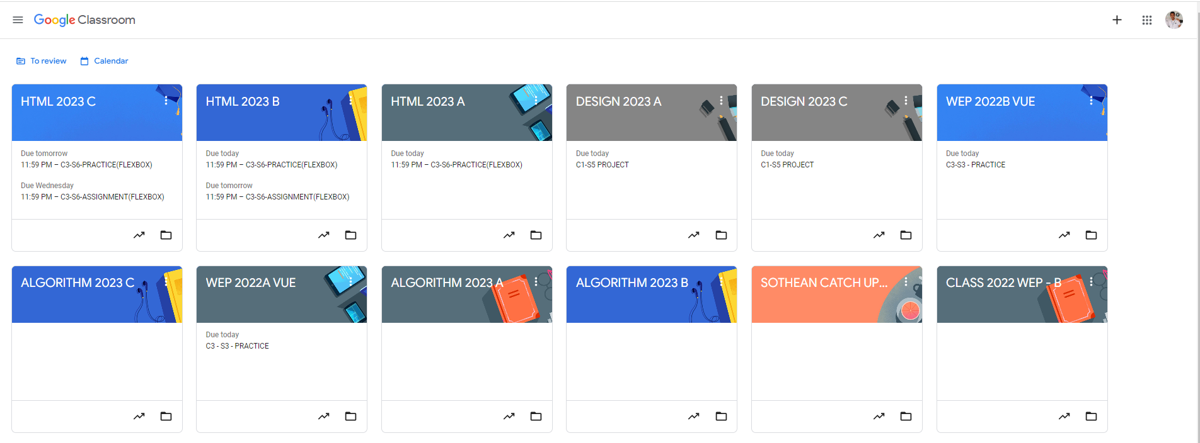
Root div
- Height: 100vh
content
nav
Flex: 0
header
Flex: 0
Flex: 1

Slide 3
Root: height 100vh
Nav-container: flex 0
Nav-link container
link
link
link
link
Header: flex 1
Main: flex 2
Main-left-section
Flex 1
Main-right-section
Flex 2

